Slide 1
V1 to V2: How and why we completely rebuilt our Live data platform
18th October, 2018 Justin Foley
Technical Manager, Dictionaries Systems Team
Email: justin.foley@oup.com

Slide 2
Agenda
The LEAP platform
What was wrong with LEAP1?
LEAP2 – What did we do?
Architecture
Data model
Testing and Acceptance Tests
LEAP2 – How did we do it?
Take-Aways

Slide 3
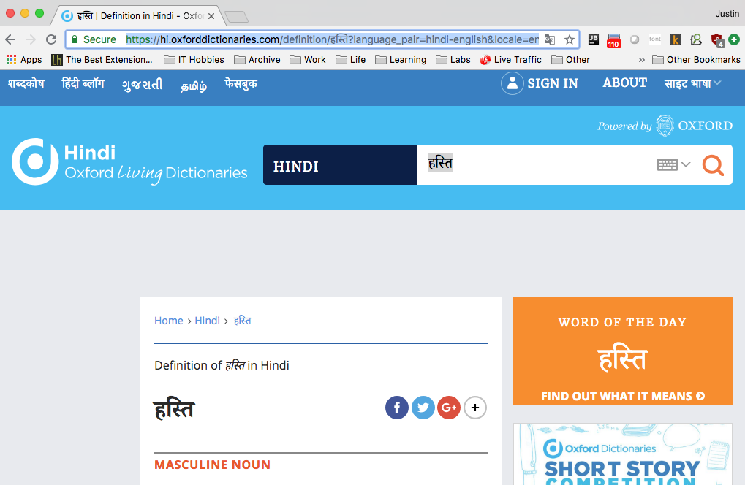
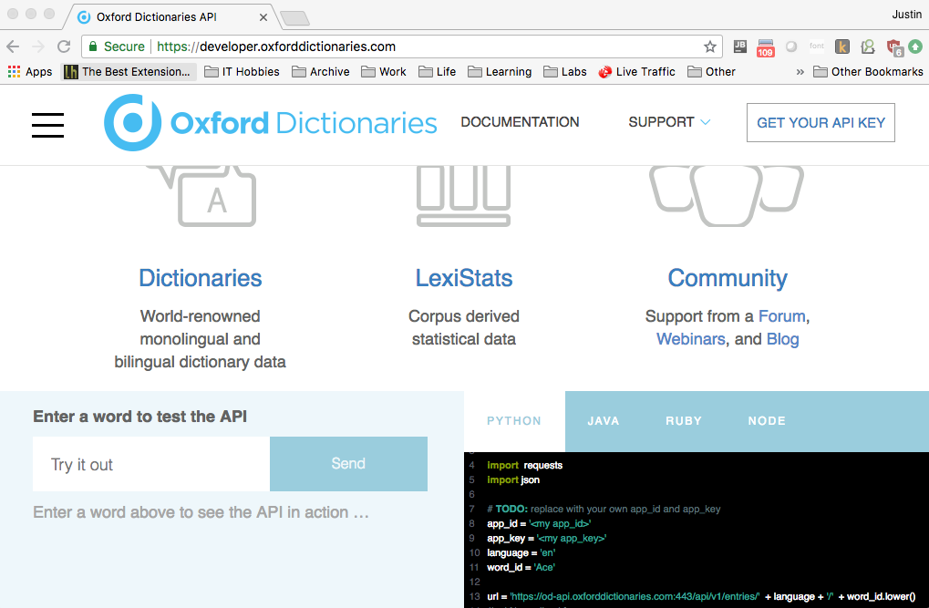
LEAP Data Platform Supports…. (Lexical Engine and Platform)
Oxford Global Languages Websites
20+ languages
www.oxforddictionaries.com
Developer API
Apps, Learning tools, Research,
Individuals, Enterprises and Institutions
developer.oxforddictionaries.com

Slide 4
Developer API
Quick Python REST example
import requests
headers = {'app_id' : ‘MY_ID’, 'app_key' : ‘MY_KEY’}
url = ‘https://od-api.oxforddictionaries.com:443/api/v1/entries/en/’
entry = “monty_python's_flying_circus”
result = requests.get(url + entry, headers = headers).json()
print(result["results"][0]["lexicalEntries"][0]["entries"][0]
["senses"]["definitions"][0])
An influential British television comedy series (1969–74) noted for its surrealist style of
humour and starring, among others, John Cleese.
Notes:
A simple example to look up the definitions of the word python in English.
The JSON result model is quite detailed and is documented on the website with some examples.
It is freely available to anyone with a simple registration. There are also configurable examples you can run in the documentation on the website without registering.

Slide 5
Data in LEAP
Dictionaries
Bilingual
Monolingual
Increasingly Language Data
Structured machine-readable
Statistics e.g. word usage frequencies, Corpus derived data on language usage, colocations
Increasingly we are using it for exporting and licensing large datasets
<XML />
{JSON}

Slide 6

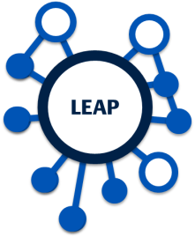
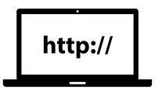




LEAP1 – What we had before
API
English & Spanish
Scripts
ODO Data Editor (DPS)
ODO (en, es) and OGL
Language Conversion Pipeline
XML
ODO & OGL Data
OGL langs
API Platform
Developer Program
Data pipeline worked
Supported 16+ language websites, 6-8 added per year
Growing developer API programme
Live API platform very stable and low cost
Many DevOps processes were working well

Slide 7
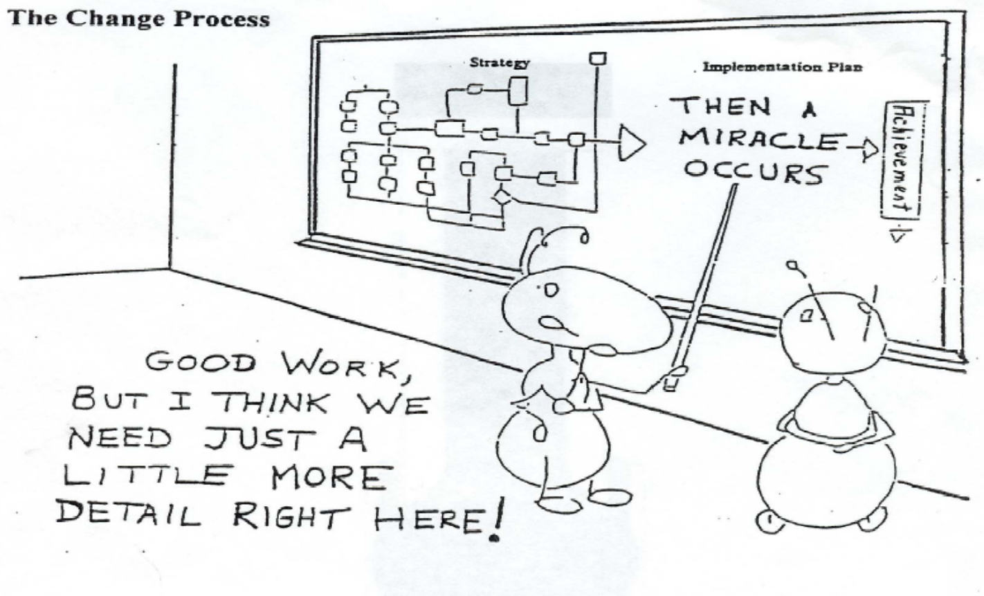
What was wrong with LEAP1?
Complex Linked Data model
Few in team understood the model – single points of failure
Model was not providing measurable business value

Slide 8
What was wrong with LEAP1?
Outwardly good – internally unscalable!
Long SLOW data pipeline (+10hrs)
Hard process to debug
Weak brittle testing
Languages tested not the pipeline
Developers running data conversions not writing code

Slide 9
LEAP 1 Architecture (simplified)
Duplicated stack for Web and Dev API
X2 – 1 for Web, 1 for Dev API
AWS
Offline Pre-processing
S3
Load Balancer
XML
XSLT 1
XSLT 2
ES Prep
(Python)
ElasticSearch
RDF Import
5h
5h
Python API
NGINX Gateway
Linked Data
DB Process
(Python)
Postgres
(RDS)
Notes:
The way the system had evolved we had 2 separate stacks: one for Web and one for Dev API. The pipeline would be run separately for each environment

Slide 10
LEAP2 – What did we do?
Repeatable BAU data pipeline
Takes about 20% of the time of L1 pipeline
Fewer steps – APIs served directly from Master Model data but cached
Standardised data features – converting all languages via the same tested process
Minimal supervision needed
New Master Data Model
Based on Dictionaries Domain Model
JSON model - closer to API output format
Simpler, cheaper, more scalable JSON database used

Slide 11
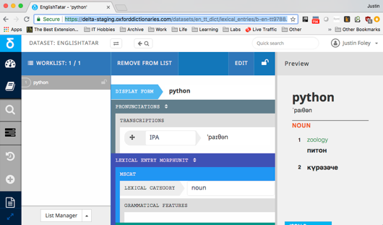
LEAP2 – What did we do?
Strong testing of the pipeline
Test standardised data features which support all languages.
A few specific language smoke tests.
New DELTA Editorial system
Integrated with LEAP2 via APIs
Increased DevOps practices

Slide 12
LEAP2 - Cached Live Master Store
Unified platform for Web and Dev APIs
AWS - Kubenetes
S3
Import API
XML
Import Validation
Cache DB
Web API (Python)
Load Balancer
NGINX Gateway
Import Transformation
ElasticSearch
Master
Store
Master Format
Dev API (Python)
NGINX Gateway
DELTA Editing System
Edit API
Notes:
One stack for multiple APIs.
Import is done once with a single pipeline and multiple APIs are served from the same ElasticSearch store.
We use identical stacks where we want to import data into test environments and promote it to Live.
New DELTA Editorial System for editing and adding new content.

Slide 13
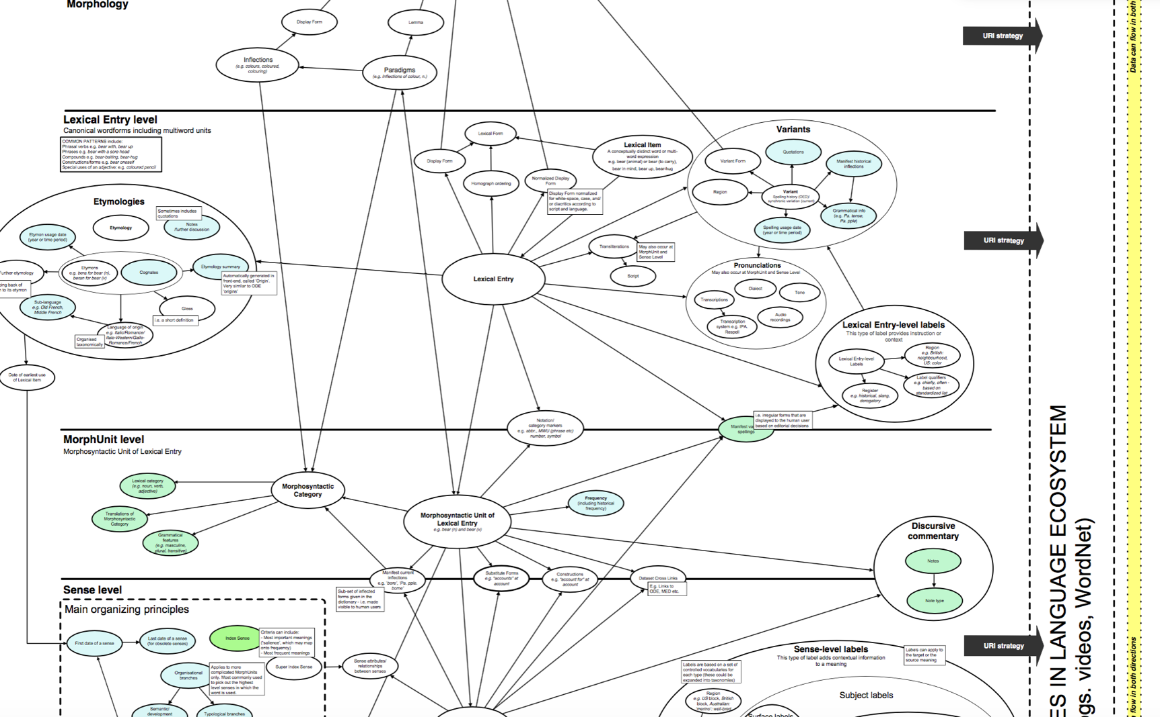
Domain Model
Conceptual high level model
Notes:
The Domain Model is a conceptual representation of all the high level concepts that are inherent in our Dictionary data using the terms of the domain.
This was constructed by gathering information from the people in the business; the focus on the concepts and key data items and their relations and is not an implementation or representation guide.

Slide 14
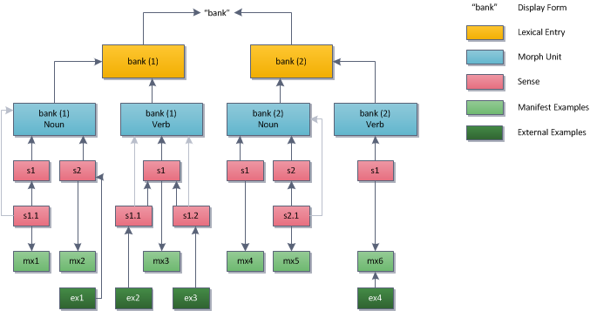
JSON Master Model

Slide 15
Implementation - Document Granularity
Whole Dataset One Document
e.g. many historic XML formats
One Doc Per
Lex Entry,
Morph Unit,
Sense,
Example
One Doc Per
Concept
(Graph)
One Doc
Per Full
Entry
LEAP2
LEAP1
JSON Doc Store - ES
Linked Data / Graphs

Slide 16

LEAP 2 Testing and Dev Process
Developers
machine
CI Servers - Jenkins
Unit Tests
Unit Tests
E2E Acceptance Tests
E2E Acceptance Tests
Automated Deployment
Deployed LEAP2
Load Tests
API
Smoke Tests
API

Slide 17
Acceptance Tests
Test End to End with Real Inputs and Outputs
Test for Web API
Generate Input
XML
Import Data
Make API Call
Check expected Results
System Under Test
ElasticSearch
Master
Store
Web API (Python)
XML
Import API
Notes:
Tests test data features and expected results via the real APIs of the system
We have similar tests for other APIs and processes in the system
Don’t change nearly as often as unit tests. Test real external interfaces.

Slide 18
Acceptance Test
Domain Specific Language in Python
class EntryTests(LeapTestCase): def test_should_retrieve_headword_from_ode(self): # GIVEN self.leap \ .with_input_file(type="monolingual", source_language="en-gb", title="ODE") \ .with_entries([
Entry(entry_id="e1", heading=Heading(headword="dog",
lexical_category=LexicalCategory(taxonomy_id="noun", text="Noun")), senses=[
Sense(sense_id="s1", definitions=[
Definition("A domesticated carnivorous mammal")
])
]) ]).create_file() # WHEN self.leap.import_input_file() # THEN self.leap.web_api() \
.expect_web_entry("en", "dog", source="ode").exists() \
.has_headword("dog")
Notes:
Domain Specific Language – Entries, Senses, Import, Web API, Headword.
Uses the language of our domain and system.
Build on standard Python Unit Test frameworks – LeapTestCase inherits from unittest.TestCase. Runs in Nose or PyTest test runners etc…
But all the Python testing language is hidden in the framework so it is not exposed to test writers. No asserts in the test.
Like BDD approaches.
Advantages over BDD text framework – you can directly breakpoint and debug tests.

Slide 19
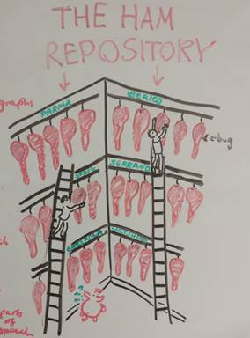
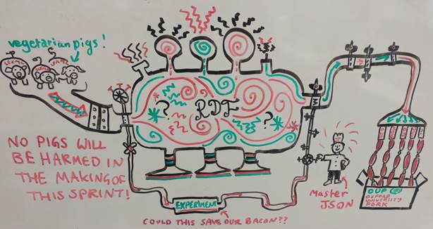
LEAP2 – How did we do it? (1)
Took advice
External technical consultation (Experienced data experts)
2 sets of consultants gave us different opinions. We took ideas from both.
Prototypes
We ran 2 prototyping sprints to prove architecture and test approaches
HAM vs Sausage Machine

Slide 20
LEAP2 – How did we do it? (2)
Defined / limited the scope
Kept the inputs and outputs the same
Input to pipeline and Output APIs mostly unchanged => targeted improvements
Simple Architecture
Tried the simplest thing that worked first
One code repo
Minimum Viable Product (MVP) first
Built LEAP2 for the next 2 OGL languages only – just enough to support them
Proved the value of the platform before investing in migrating everything
Automation, Testing and DevOps from Day One
Progressive Migration - to cover all that LEAP1 did but in phases

Slide 21
Take-Aways
A system can be outwardly successful but internally unworkable.
Focus on your core Use Cases – internal and external.
For us the data model and its processing is key.
Build on your existing strengths – keep what works.
Simplify as much as you reasonably can.
Do things progressively and limit scope
Prototypes, MVPs, limit changes to external interfaces.
Testing and automation
Easier to do early.
Save a lot of time in the long run.

Slide 22
References / Resources
Domain Specific Languages - https://martinfowler.com/books/dsl.html
Domain Modelling and Domain Driven Design - http://domainlanguage.com/ddd/

Slide 23
Any questions?

Slide 24
Building Microservice REST APIs with Flask
Lessons learned from hosting public and private APIs
18th October, 2018 Jose Vallejo
Language Technologist, Dictionaries Systems Team
Email: jose.vallejodiaz@oup.com

Slide 25
Agenda
Fundamental Concepts
Microservices Vs Monolithic
Development
Microservices and Microframeworks (Flask)
Deployment
Containers World
Scalability
Microservices Orchestration

Slide 26
Fundamental Concepts

Slide 27
Monolithic Architecture
Fundamental Concepts
Entry
Get entry
Developers
Database
Update entry
Database
Examples
Web
Database
Promote
entry
Response
Database
Senses
Editors
Get entry
Request
Notes:
Traditional Architecture
All components in one
Horizontal Layers
Each layer has an specific role.
Abstraction between layers (Presentation layer doesn’t know about Persistence Layer)
Dependencies between layers
Data Access Object Pattern
This architecture makes it very difficult to scale. Changes are also complex due to inherent dependencies within the system

Slide 28
Service Oriented Architecture
Fundamental Concepts
Developer API
Developers
Database
Edit
API
Web
Database
Response
Web
API
Database
Editors
Request
Notes:
Break it into services
Each service does a specific thing
The Services are interconnected

Slide 29
Microservices Architecture
Fundamental Concepts
Website
Editors
Developers
Admin
API Gateway
Search Module
Editor Module
Search Module
Management
Module
Web Formatter
Edit Formatter
Developer Formatter
Notes:
An evolution of the Service Oriented Architecture:
Separated Services components
Service components contain more than one module
Separately Deployed unit
Easy to test
Highly scalable – 2 dimensions
Horizontal scalable (More service components)
Vertical scalable (Larger Infrastructure )
Distributed Architecture
Fully decoupled
Easily Accessible (REST, SOAP, RPC…
Microservices are not suitable to solve problems which require high performance
Low coupling
High Cohesion
Break it down into Services
Scalability
Testability

Slide 30
Development

Slide 31

What should I use?
Development
Agile Practices
BDD
Continuous Integration
Notes:
Minimalistic web Application Framework.
No Persistence layer
Just two dependencies
Werkzeug (WSGI Daemon)
Jinja
Several Flask extensions
Flexibility + Simplicity
Production ready

Slide 32

How to do it?
Development
Keep Calm

Slide 33
Web Server Entry Point
Development
def uwsgi_app(): web_application = configure_app() return web_application.flask_app
def configure_app(api_version="v3", code_version_file_path="VERSION"):
# Reads config file or environment variables …
query_manager = QueryManager(MasterStore(), CacheManger(), DeveloperFormatter())
return DeveloperApplication(query_manager)
Notes:
Def uwsgi_app() - > is used by uwsgi server and it just runs - we don’t have to care about anything else

Slide 34
Define URL path
Development
class DeveloperApplication: _name = 'public_apis.developer' def __init__(self, query_manager): if app is None: app = Flask(self._name) self.flask_app = app self.api.add_url_rule('/entries/<lang:source_lang>/<word_id:word>’,
view_func=RetrieveEntryView.as_view('entries’,
query_manager=self.query_manager,
languages=self.languages)
)
def start_application(self, host='0.0.0.0', port=5000):
self.flask_app.run(host=host, port=port, use_reloader=True)
Notes:
We encapsulate the Developer application to configure the correct url of our API

Slide 35
View Decorators
Development
@api.route('/entries/<source_lang>/<word_id:word>') def retrieve_entry_endpoint(source_lang, word): dataset = define_dataset(source_lang, None, region) # Get the results. word_id = label_to_id(remove_punctuations(word)) results = retrieve_logic(db, source_lang, None, word_id)[2]
result = add_metadata({'results': results}) return json_response(result)

Slide 36
Class-Based Views
Development
class RetrieveEntryView(MethodView): def __init__(self, query_manager, languages): self.query_manager = query_manager self.languages = languages
def get(self, source_lang, word):
entries = self.query_manager.get_entries(word, source_lang)
return json_response(entries)
Notes:
You define as class methid the different HTTP method that this endpoint support

Slide 37
Deployment

Slide 38
Web Server Config
Deployment
[uwsgi] base = /app/leap2 app = leap module = leap.public_apis.developer.developer_api plugin = python3
callable = uwsgi_app() http-socket = 0.0.0.0:8000
Notes:
Creating a docker image could get complex so it is important to test that the image is built properly – Continuous deployment or Continuous delivery

Slide 39
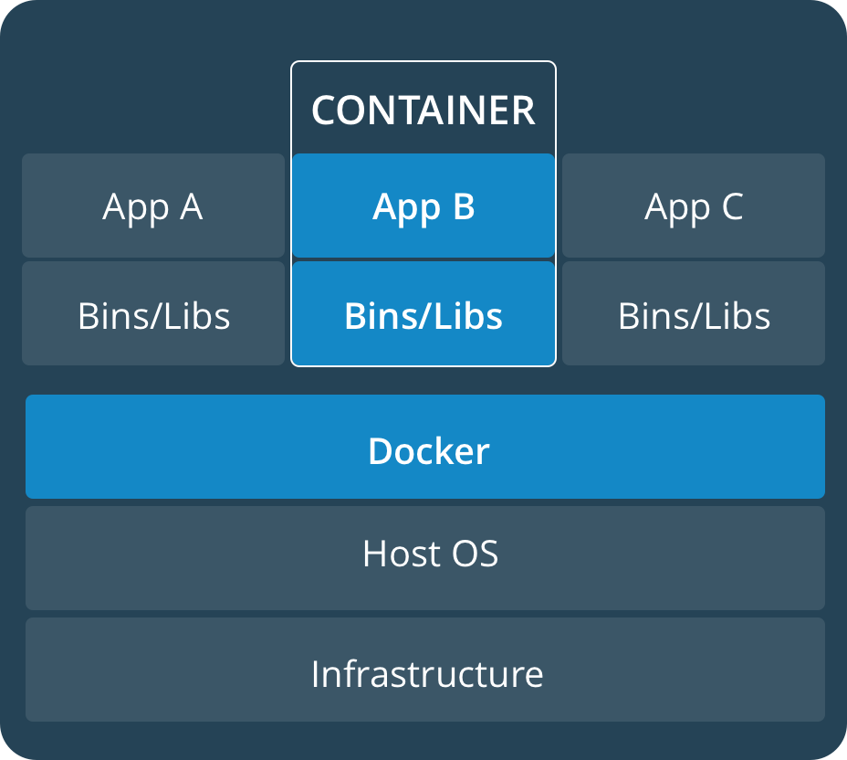
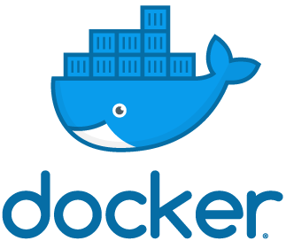
Containers World
Deployment
Notes:
Docker: Implements a high-level API to provide lightweight containers that run process in isolation

Slide 40
Building a Docker Image - Dockerfile
Deployment
FROM gliderlabs/alpine:3.6 RUN apk add --no-cache python3 python3-dev uwsgi uwsgi-python3 RUN pip3 install virtualenv WORKDIR /app COPY requirements /app/requirements COPY dist /app/dist COPY config /app/config COPY schema /app/schema
RUN virtualenv /env && /env/bin/pip install -r /app/requirements/live.txt && /env/bin/pip install /app/dist/leap2*.whl CMD uwsgi --ini /app/config/uwsgi.ini EXPOSE 8000
Notes:
Creating a docker image could get complex so it is important to test that the image is built properly – Continuous deployment or Continuous delivery

Slide 41

Kubernetes Cluster
Deployment
SVC
SVC
Pod
Pod
Pod
Service
Pod
Pod
Pod
Service
Pod
Pod
Pod
Notes:
Kubernetes is a system that helps us to deploy microservices using docker containers
Pod Deployable unit
Services interface where pods are exposes
Deployment strategies: Recreate, Blue/green, Canary (sub set of users), Roll out a new version, and others…

Slide 42
Deploy a Container on Kubernetes
Deployment
apiVersion: v1 kind: Service metadata: name: api labels: app: api spec: ports: - port: 8000 targetPort: 8000 selector: app: api version: api-0.1
apiVersion: extensions/v1beta1 kind: Deployment metadata: name: api spec: replicas: 2 template: metadata: labels: app: api version: api-0.1 spec:
containers: - name: api image: developer-api:2.2.3 ports: - containerPort: 8000 resources: requests: memory: "150Mi" cpu: "150m" limits: memory: "300Mi" cpu: "300m"

Slide 43
Scalability

Slide 44
Horizontal Scale
Deployment
API GATEWAY
Service
Pod
Pod
Pod
Service
Pod
Pod
Pod
Service
Pod
Pod
Pod
kubectl autoscale deployment developer-api --cpu-percent=60 --min=3 –max=30

Slide 45
Horizontal Scale
Deployment
API GATEWAY
Service
Pod
Pod
Pod
Pod
Pod
Service
Pod
Pod
Pod
Pod
Pod
Service
Pod
Pod
Pod
Pod
Pod

Slide 46
Vertical Scale
Deployment
API GATEWAY
Service
Auto Scaler
Pod
Pod
Pod
Pod
Pod
Service
Pod
Pod
Pod
Pod
Pod
Service
Pod
Pod
Pod
Pod
Pod
Service
Pod
Pod
Pod
Notes:
To scale vertically a node can monitor the capacity of the other nodes and add nodes to the cluster to make its capacity bigger when required

Slide 47
Take Away
Summary
Low coupling and High Cohesion.
Small Deployable Units.
Distributed Architecture.
Highly scalable
Less suitable when Very High Performance is Required.
Align with Agile Practices
Continuous Integration, but If you can implement Continuous Deployment.
CD is important specially when we use Docker.
Microservices Orchestration makes our Life much easier.

Slide 48
Resources
Microservices: Building Scalable Software – Sourab Sharma
Software Architecture Patterns – Mark Richards
Building microservices – Sam Newman
Microservices – Flexible Software Architecture – Eberhard Wolff
Microservices Blog – Martin Fowler
Microframework – Wikipedia
https://docs.docker.com/ - Docker Docs
https://kubernetes.io/docs - Kubernetes Docs

Slide 49
Any questions?

Slide 50
We’re hiring!
OUP Dictionaries have an excellent opportunity for an enthusiastic Python Developer with an interest in DevOps to help us build language data systems.
Apply directly at jobs.oup.com
https://jobs.oup.com/uk/jobs/vacancy/521/description
Justin.Foley@oup.com
Tamara.Bowler@oup.com

